Slide 1


Post-Brexit Economy
May 2019

Slide 2
Post-Brexit Economy
“My beliefs when I first became an MP are the same things that drive me 22 years later as Chancellor of the Exchequer. A belief in the market economy as the best, indeed, the only way to deliver future prosperity for the British people. A belief in Britain as an open, tolerant, outward-looking nation, confident and competitive in the world. And above all, a belief in the power of business – that self-starters, entrepreneurs, investors are the engine of our
economy, and the bedrock of our communities.”
(Rt Hon Philip Hammond MP, 22 March 2019)

Slide 3

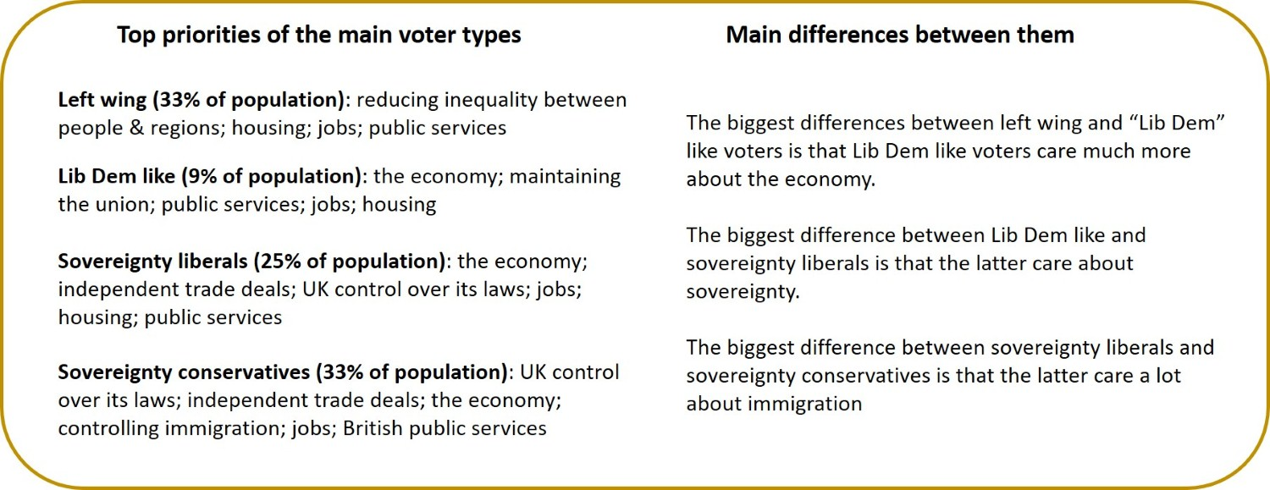
Post-Brexit Economy

Slide 4
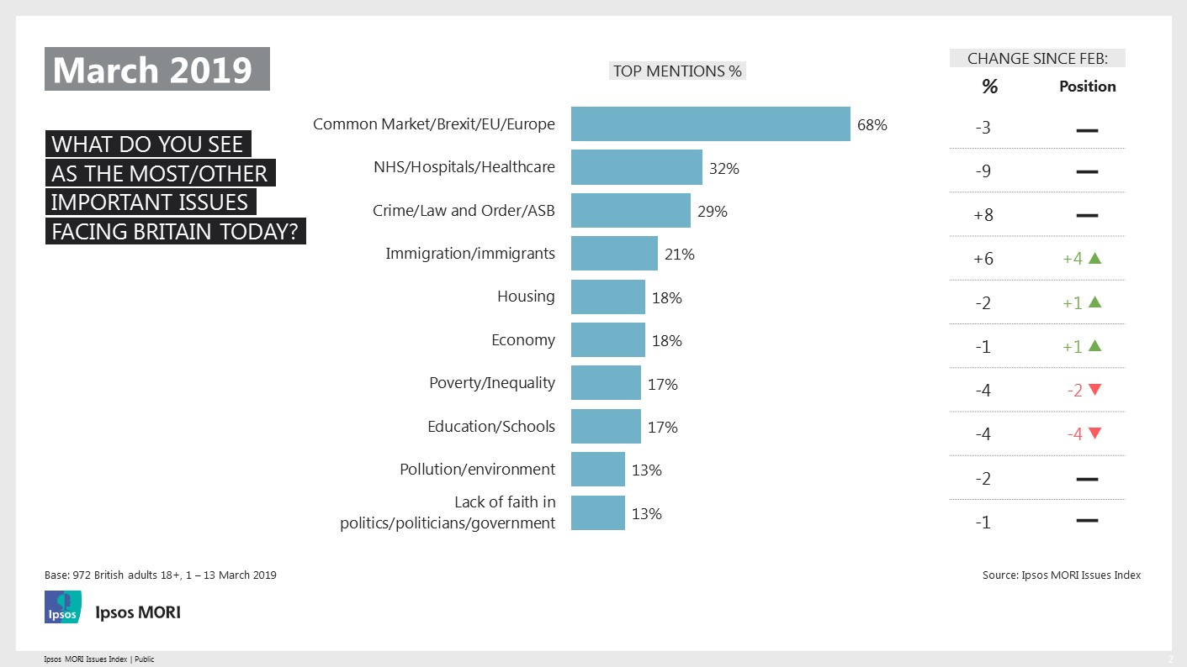
Post-Brexit Economy

Slide 5
What Our Manifesto Said
A STRONG ECONOMY THAT WORKS FOR EVERYONE (p.12)
A strong economy built on sound public finances, low taxes, better regulation and free trade deals with markets around the world.
A new deal for ordinary, working people giving them a decent living wage and new rights and protections in the workplace.
Fairer corporate governance, built on new rules for takeovers, executive pay and worker representation on company
boards.
(continued)

Slide 6
What Our Manifesto Said
A STRONG ECONOMY THAT WORKS FOR EVERYONE (p.12 cont.)
Growth across the country through our modern industrial strategy and major investment in infrastructure, skills and research and development.
Competitive and affordable energy costs following a new independent review into the cost of energy.
Prosperous towns and cities, underpinned by strong local
institutions, the relocation of government functions, and
shared cultural assets across the country.

Slide 7
Questions for discussion
How do we change the focus of debate from Brexit to other concerns that matter to the wider electorate?
What should a fair Conservative tax offer look like? How should public services be fairly funded? Which services should be funded purely by local communities?
How many in your group think the government should increase spending on public services, even if that means higher taxes or more borrowing? How many disagree?
Given our Party’s commitment to delivering lower taxes for ordinary,
working people: (i) What specific taxes would you abolish or
simplify? (ii) What taxes would those who want increased
spending on services be prepared to see government raise?

Slide 8
Optional bonus questions
What further policies should we pursue to boost investment in infrastructure, skills and industry?
What investment in roads, rail, fibre and other infrastructure should we prioritise?
What should we do to make the UK the best place to build a tech business?
What should we do to maintain the UK’s leadership in Financial Services?
What should we do to boost our exports and our attractiveness as a destination for Foreign Direct Investment?
Is there any other question you think should have been asked or
observation you would like to make?

Slide 9
Next steps
Deadline for submission of responses:
31 August by email to CPF.Papers@Conservatives.com
using the supplied response form
Next discussion paper:
Under-18s Education
First week of September 2019

