Slide 1


Disability & Inclusion
November 2018

Slide 2
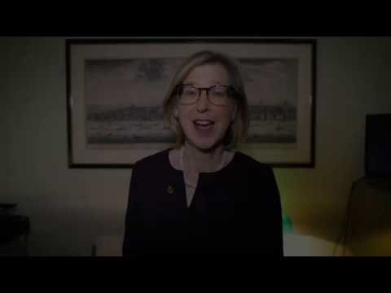

Slide 3
Disability & Inclusion
“The UK has achieved a great deal and has been at the forefront of developments in equality and disability rights. But we are clear that more needs to be done. We will continuously develop and deliver real and practical improvements to ensure disabled people have the same opportunities for inclusion as people who are not disabled.”
(Sarah Newton MP, Minister for Disabled People,
Health and Work, 3 October 2018)

Slide 4


Slide 5
Disability & Inclusion
One Nation (or “One Society”) Conservatism
“An inclusive, classless conservatism that embraces the needs, contributions and shared obligations of all communities in every region of the UK, promoting social integration, inter-generational solidarity and
an economy that fairly enables all to thrive,
rewarding hard work and responsibility.”

Slide 6
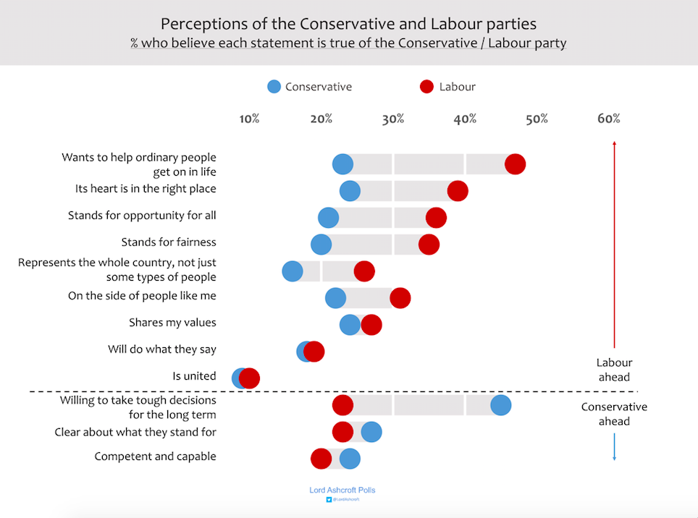

Slide 7
Disability & Inclusion
What Our Manifesto Said
“We will build on the proud Conservative record in supporting those with disabilities, including the landmark Disability Discrimination Act of 1995. We want to see attitudes to disability shift as they have for race, gender and sexuality in recent years: it should
be completely unacceptable for people with
disabilities to be treated negatively.” (p.57)

Slide 8
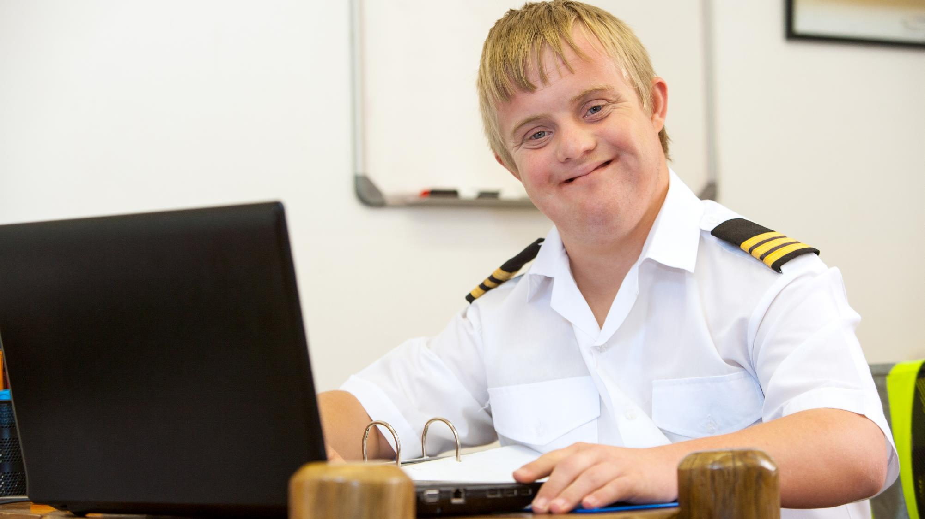
“We believe that where you live, shop, go out, travel or park your car should not be determined by your disability.” (p.58)

Slide 9
Questions for discussion
Housing: How might we better build homes and buildings that everyone can access and use, so as to build a society in which all can participate fully?
Transport: How might we better adapt our transport systems so as to offer people with disabilities the same access to transport as everyone else?
Health: How might we more effectively reduce the health gap experienced by people with a learning disability, mental health
conditions or autism, so as to help everyone to live full,
healthy and independent lives?

Slide 10
Questions for discussion
Employment: How might we work more effectively with employers and people with health conditions so as to help as many as possible to get into and stay in employment?
Participation in Society: How might we better support candidates with disabilities to stand for public office, so that those elected better reflect the diversity of society?
Culture Change: How might we all deliver positive further change for people with disabilities, so that society does not miss out on
the contribution of any person?
Is there any other question you think should have been asked
or observation you would like to make?

Slide 11
Next steps
Deadline for submission of responses:
1 January by email to CPF.Papers@Conservatives.com
using the supplied response form
Next discussion topic:
Global Britain
(part of the PM’s Policy Commission)
2 January 2019

