Slide 1


Health & Social Care
June 2018

Slide 2
Health & Social Care
“How we care for our most vulnerable citizens is the true litmus test of whether we are a civilised society – not only the care for older people but for younger disabled people who are living much longer.”
(The Rt Hon Jeremy Hunt MP, Secretary of State for Health & Social Care)

Slide 3
Health Care System Performance Rankings
 | AUS | CAN | FRA | GER | NETH | NZ | NOR | SWE | SWIZ | UK | US
OVERALL RANKING | 2 | 9 | 10 | 8 | 3 | 4 | 4 | 6 | 6 | 1 | 11
Care Process | 2 | 6 | 9 | 8 | 4 | 3 | 10 | 11 | 7 | 1 | 5
Access | 4 | 10 | 9 | 2 | 1 | 7 | 5 | 6 | 8 | 3 | 11
Administrative Efficiency | 1 | 6 | 11 | 6 | 9 | 2 | 4 | 5 | 8 | 3 | 10
Equity | 7 | 9 | 10 | 6 | 2 | 8 | 5 | 3 | 4 | 1 | 11
Health Care Outcomes | 1 | 9 | 5 | 8 | 6 | 7 | 3 | 2 | 4 | 10 | 11

Slide 4
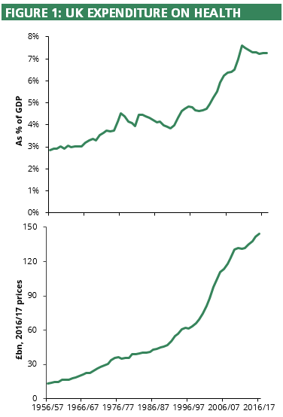

Slide 5
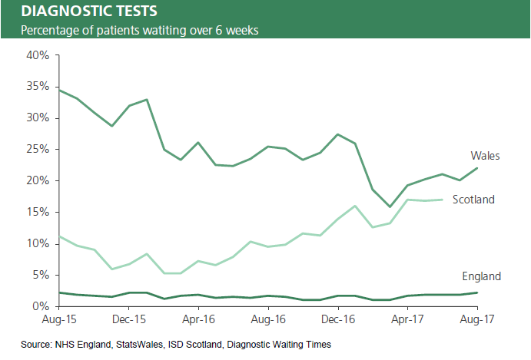

Slide 6
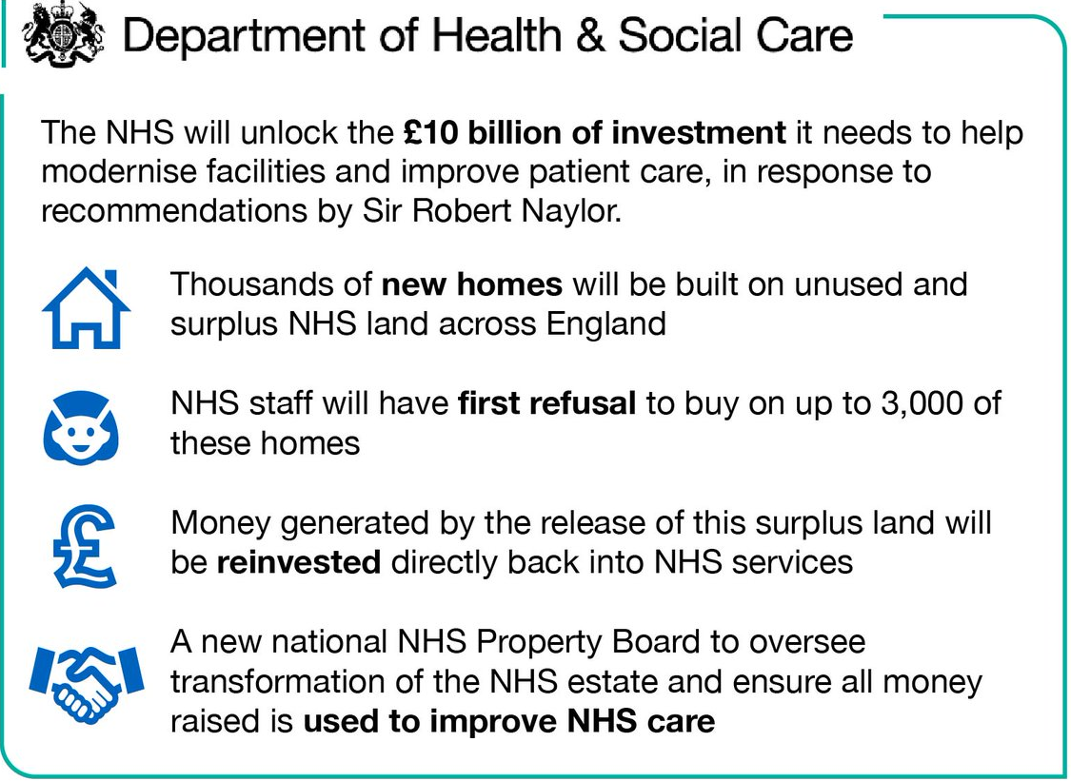

Slide 7
Health & Social Care
What Our Manifesto Said
“Theresa May’s Conservatives will deliver … Exceptional healthcare, whenever, wherever, delivered by an NHS with the money, buildings and people it needs.” (p.62)

Slide 8
Questions for discussion
How has your experience of access and care in the NHS changed in recent years?
Given the profoundly different landscape of 21st-century healthcare compared to when the NHS was founded 70 years ago, what should the role of the state be?
What more could be done to support individuals and families to take more control of their own health and wellbeing? How might we shift from a system based on treatment to prevention of disease?

Slide 9
Questions for discussion
How might we help people to use the NHS responsibly, e.g. not attending A&E for issues that a GP or pharmacy can clearly resolve? How might we reduce the costs associated with the 1-in-15 patients who miss their appointments?
How could we further raise awareness and tackle the stigma associated with mental ill health?
What kinds of NHS services do you think could be put online/digital rather than traditional face-to-face?

Slide 10
Questions for discussion
What more could the NHS do to encourage people to want to work for it? What sorts of practices do you associate with really good employers in other sectors, which the NHS should adopt?
How might we continue to fund sustainably a growing NHS?
As the NHS budget grows, what health services or treatment areas should be prioritised?

Slide 11
Questions for discussion
What could be done to raise awareness among working age adults about the risks of future care costs? How should we fund the need for increased social care?
What should be the guiding principles for Conservatives in making these decisions?
Is there any other question you think should have been asked or observation you would like to make?

Slide 12
Next steps
Deadline for submission of responses:
31 August by email to CPF.Papers@Conservatives.com
using the supplied response form
Next discussion paper:
The challenge and opportunities of the digital age
3 September 2018

