Slide 1
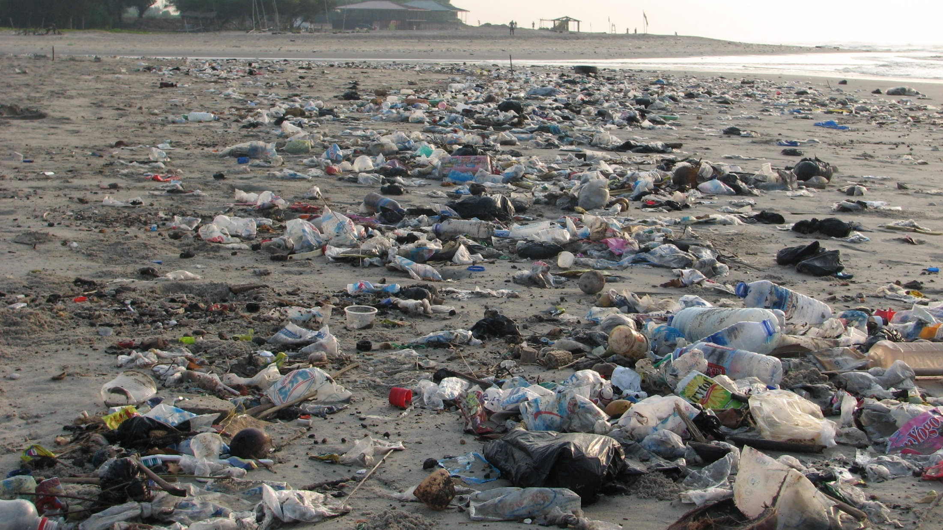

Conservative Conservation
“The Conservatives always have to clean up Labour’s mess…”
March 2018

Slide 2
Conservative Conservation
“The clue’s in the name: Conservatives are – and always have been – the world’s best conservationists.”
(James Delingpole)

Slide 3
Conservative Conservation
“Respecting nature’s intrinsic value and making sure we are wise stewards of our natural world is critical if we are to leave the environment in a better state than we inherited it. Our Environment Plan sets out how over the next 25 years we will radically reduce the waste that is choking oceans and rivers, cleanse our air of toxic pollutants and create new habitats for our most precious wildlife to thrive.”
(The Rt Hon Michael Gove MP, Secretary of State for
the Environment, Food & Rural Affairs)

Slide 4
The Challenge
Without action we face the progressive loss of the natural capital on which all growth—natural, human and economic—ultimately depends. Among 18-24-year-olds, climate change is the top issue that young people believe should be discussed more often by politicians.

Slide 5
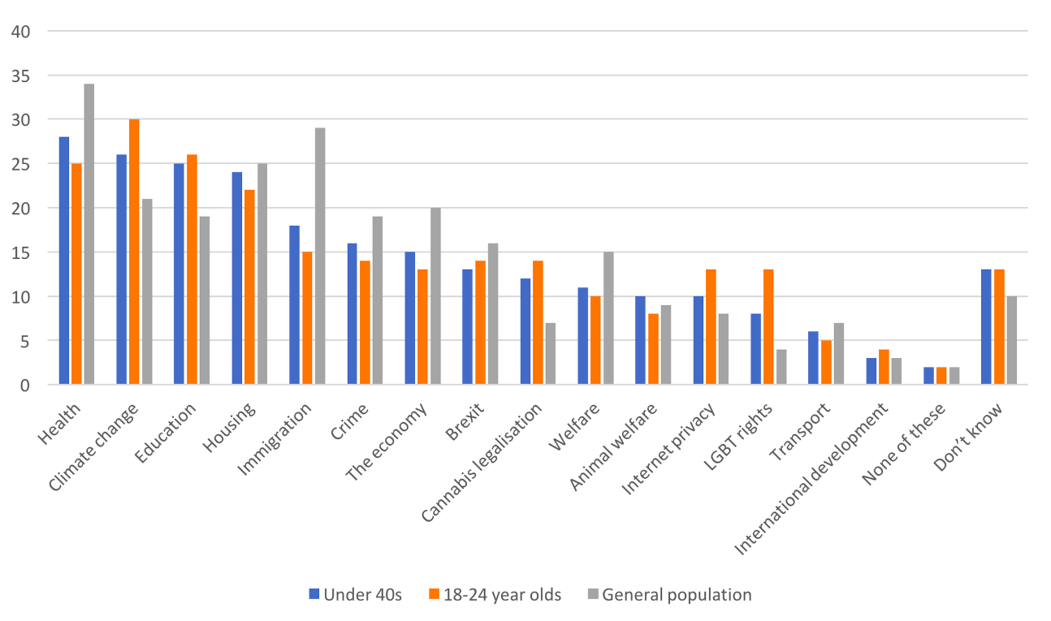
The top three policy issues voters feel senior politicians do not discuss enough and want to see them discuss more, according to age

Slide 6
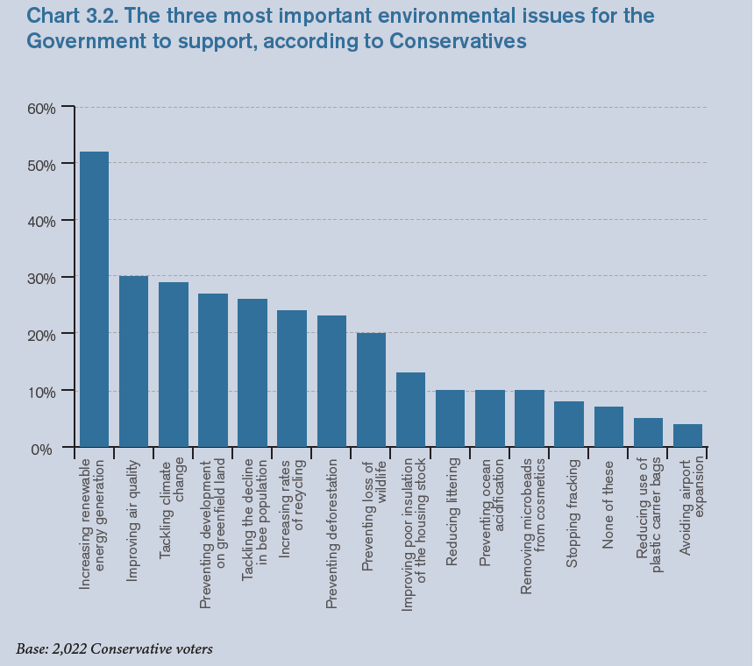
The three most important environmental issues for the Government to support, according to Conservatives

Slide 7
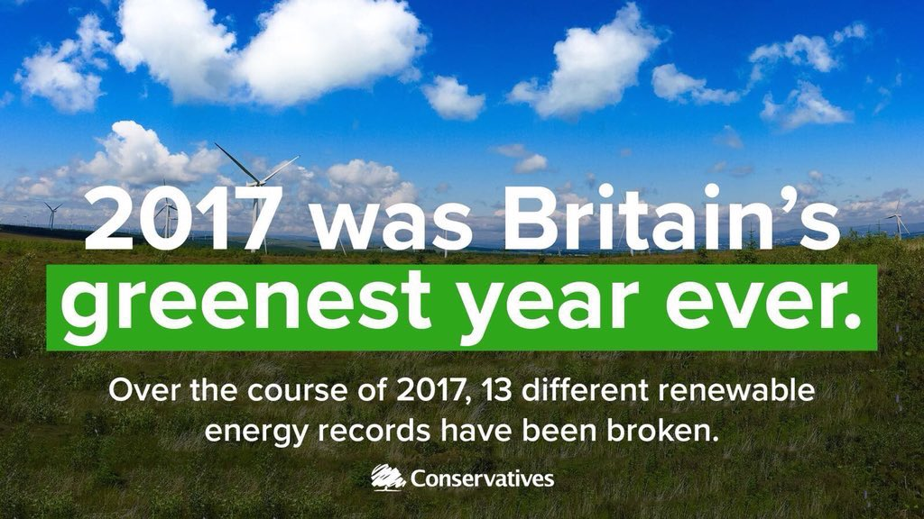

Slide 8
The Conservative Track Record
“Conservative Governments have always taken our responsibility to the natural environment seriously.” (The Rt Hon Theresa May MP, Prime Minister)
Labour’s Record of Failure
“Labour has too often treated the environment in a way that suggests it’s come as an afterthought.” (Angela Eagle MP, Shadow Treasury Minister, 2015)
What Our Manifesto Said
“As Conservatives, we are committed to leaving the
environment in better condition than we inherited it.”

Slide 9
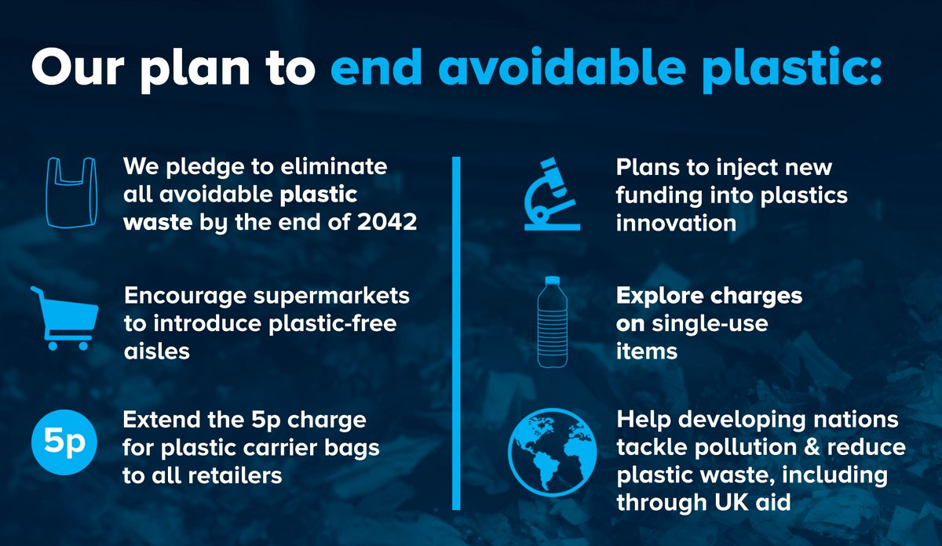

Slide 10
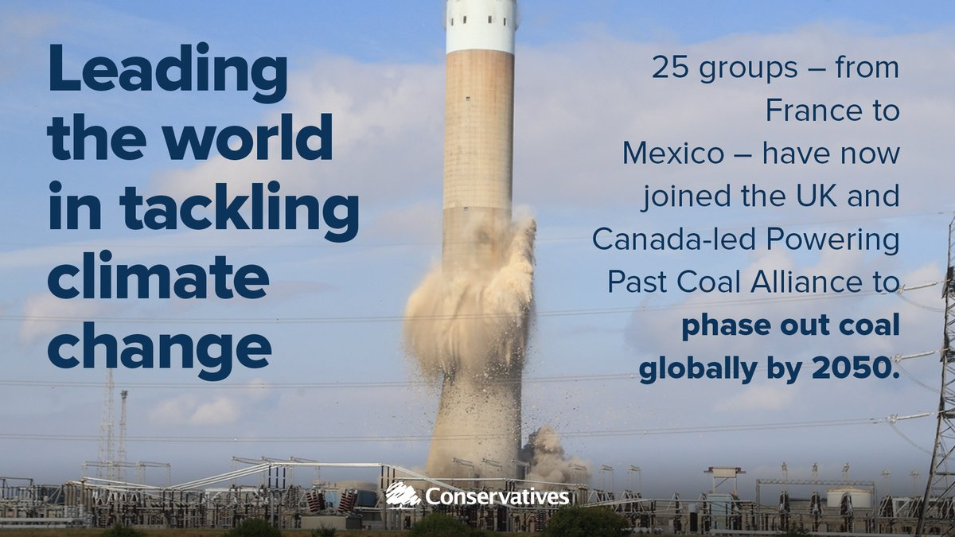

Slide 11
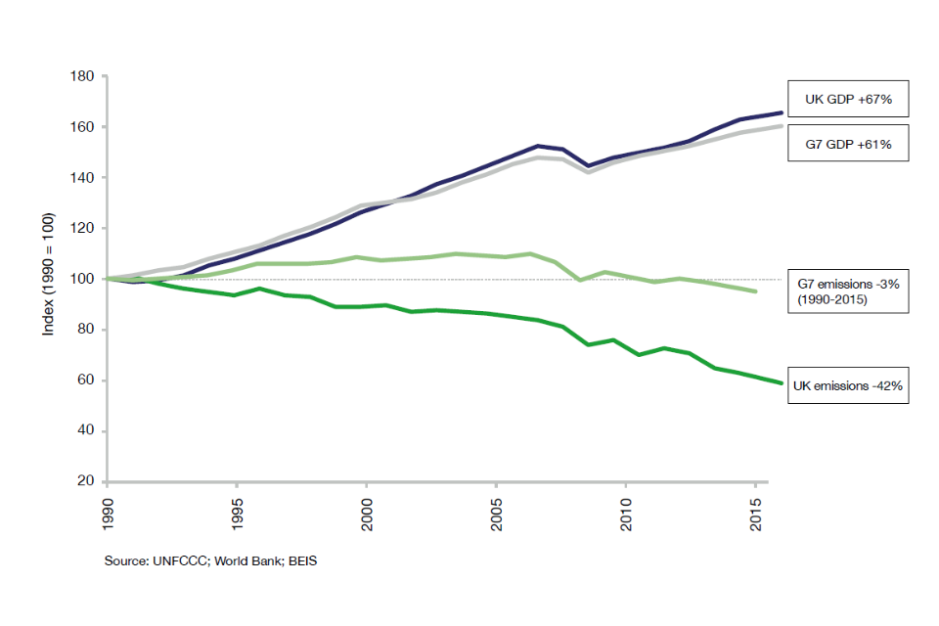
UK and G7 economic growth and emissions reductions

Slide 12
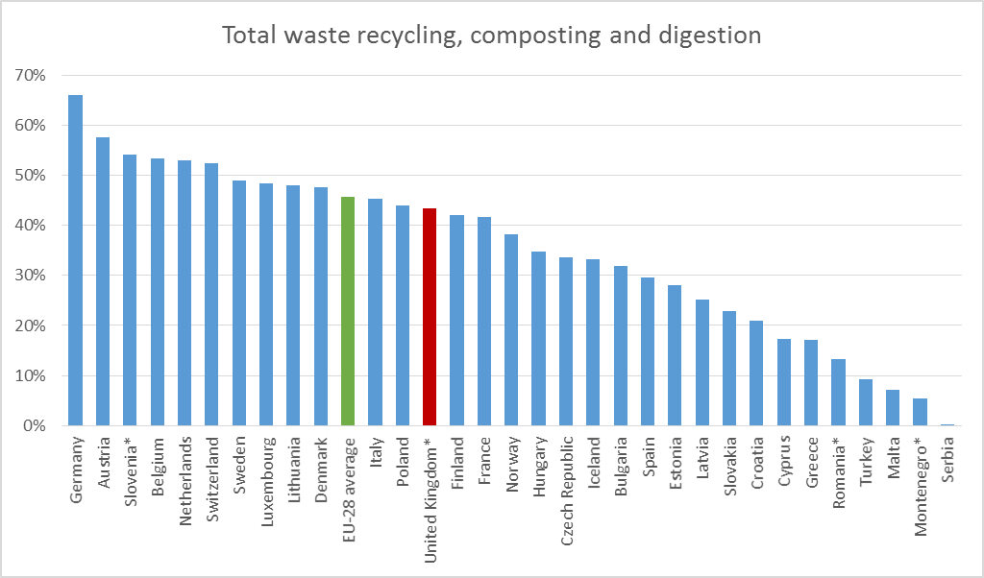

Slide 13
Questions for discussion
Climate change: How might we better cultivate the resources, policies and people that will allow us to mitigate and adapt to change?
Renewable energy generation: How might we transition more quickly away from an over-dependency on non-renewable fossil fuels?
Air quality: What policies should we enact to reduce harmful pollutants?
Plastics: What policies should we enact to reduce the amount of plastic waste and increase recycling?
Trees: How can we encourage more tree planting?
Farming and fishing: What should farming and fishing policies
look like outside of the European Union?

Slide 14
Questions for discussion
Brexit: How might we use the opportunity that leaving the EU provides to strengthen and enhance our environmental protections?
Global leadership: How else might we further build on our global leadership and existing commitment to international development so as to create international coalitions to tackle particular environmental challenges? Or should we be focusing more on improving our own country’s environmental quality?
In what ways should the Government harness market mechanisms
and regulation—from auctions and subsidies, to taxes and bans—
to support best practice and to encourage greater investment in environmentally-friendly goods and services?
How might your proposals be paid for?

Slide 15
Next steps
Deadline for submission of responses:
31 May by email to CPF.Papers@Conservatives.com
using the supplied response form
Next discussion paper:
Health and social care
1 June 2018

