Slide 1


Skills and Training for a
21st Century Workforce
January 2018

Slide 2
Skills and Training
Emerging challenges for the 21st-century workplace include:
Productivity & Globalisation
Technological Change
Changing Skill Requirements

Slide 3
Productivity & Globalisation
“Boosting productivity is the economic challenge of our age.”
(The Rt Hon Sajid Javid MP, Secretary of State for Business, Innovation and Skills, 10 July 2015)

Slide 4
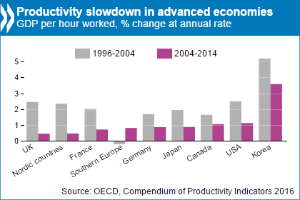
Productivity & Globalisation

Slide 5
Productivity & Globalisation
Labour Productivity Growth Trend, average annual rate, percentage

Slide 6
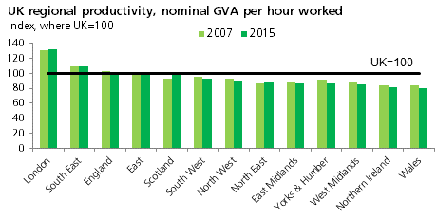
Productivity & Globalisation

Slide 7
Productivity & Globalisation
GDP per hour worked in countries across the OECD, USD, 2016 or latest data

Slide 8
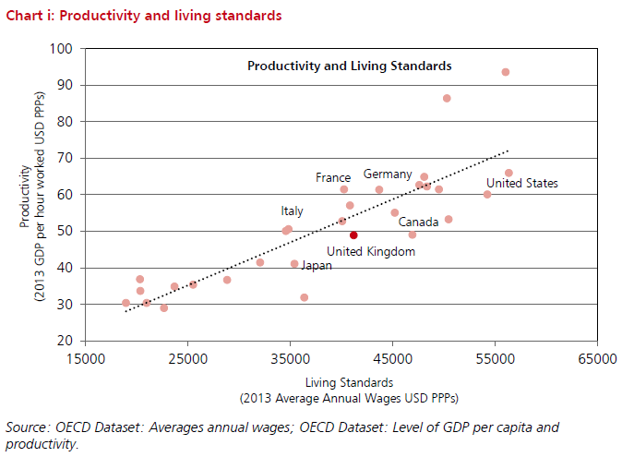
Productivity & Globalisation

Slide 9
Technological Change
“Should driverless cars become ubiquitous, families will be able to spend their savings on something far more useful than a steel box that spends most of its life sat on the driveway. Everywhere we turn, digital technology is driving improvements in almost every sphere of life. From 3D printers producing jet engine components, to the sensors in concrete that report on its own structural integrity. From smart traffic planning, to dynamic energy demand. The fact is we are just in the foothills of a new technological revolution, that will do even more to lift living standards and improve the human condition.” (The Rt Hon Matt Hancock MP,
Minister of State for Digital and Culture, 8 June 2016)

Slide 10
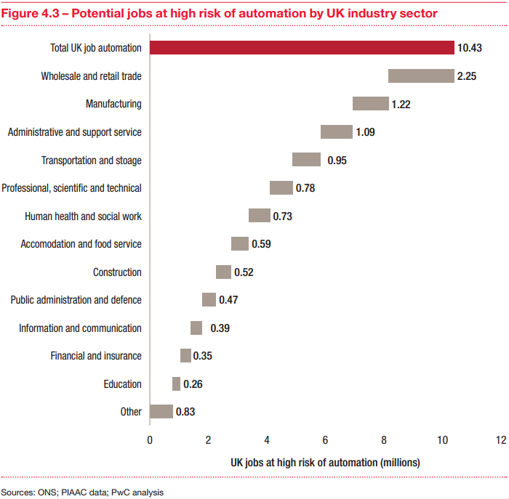
Technological Change

Slide 11
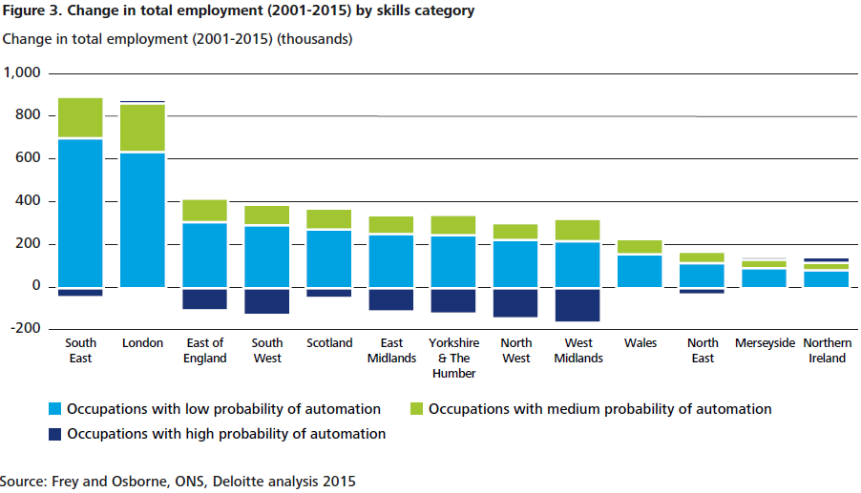
Technological Change

Slide 12
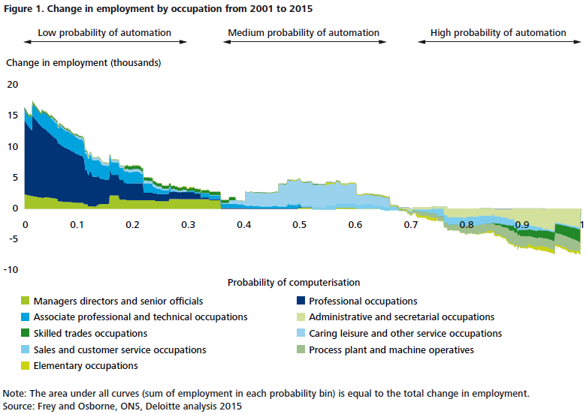
Technological Change

Slide 13
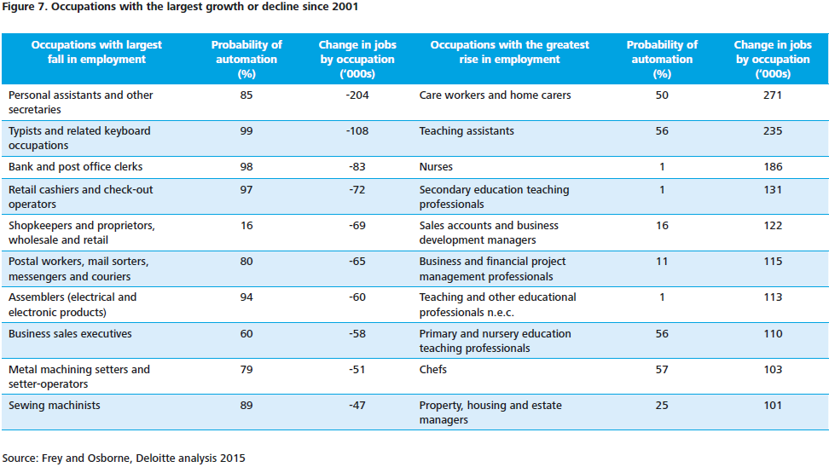
Technological Change

Slide 14
Changing Skill Requirements
“This government is committed to…ensuring the UK is the best place to start and grow a digital business, trial a new technology, or undertake advanced research - and that the UK digital sectors remain world-leading. This requires supportive regulation but also first-class digital infrastructure and an advanced skills base.” (The Rt Hon Karen Bradley MP, Secretary of State for Digital, Culture, Media and Sport, 1 March 2017)

Slide 15
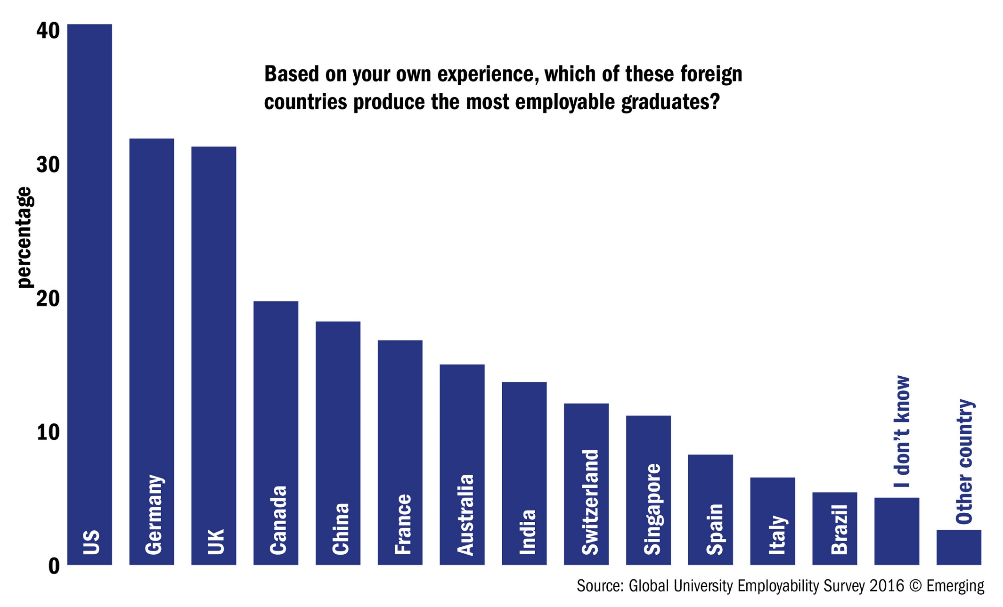
Changing Skill Requirements

Slide 16
Questions for discussion
Whose responsibility should training be: the citizen, schools and universities, the employer, the state, or all of them? In the Armed Forces when you sign-up all training is paid for in return to several years’ service, but this is not the case in the rest of the public sector. Is this fair? What new contract might we offer our citizens?
How might a Conservative Government seek to boost productivity across the UK?
In what ways could the UK build on its world-class
reputation for training and expand opportunities for
lifelong vocational education and training? Do we
need a top-down national skills programme or a
bottom-up sectoral or geographical approach?

Slide 17
Questions for discussion
In what ways does training need to catch up with the changing skill requirements of modern technology? Are there any new and innovative models of training in your area that could be used elsewhere?
How should a Conservative Government deal with possible widening income gaps arising from increased automation?
What policies should a Conservative Government adopt to
balance the need for improved training and productivity
in the UK with any desire to reduce our reliance on
skilled technical expertise from abroad? How might
these be paid for?

Slide 18
Next steps
Deadline for submission of responses:
28 February by email to CPF.Papers@Conservatives.com
Next discussion paper:
The Environment
1 March 2018

