Slide 1
Youth Issues
A New Deal for a New Generation
Autumn 2017

Slide 2
A New Deal for a New Generation
“This is the reality young people are faced with today: They fork out upwards of £27,000 to go to university, only to be told they have little to no job prospects. They move to London for a career, only to pay an average rent upwards of £1000. They’re charged by estate agents to leave a property, and they’re charged renewal fees when they sign on for another year.”
(NME, 13 June 2017)

Slide 3
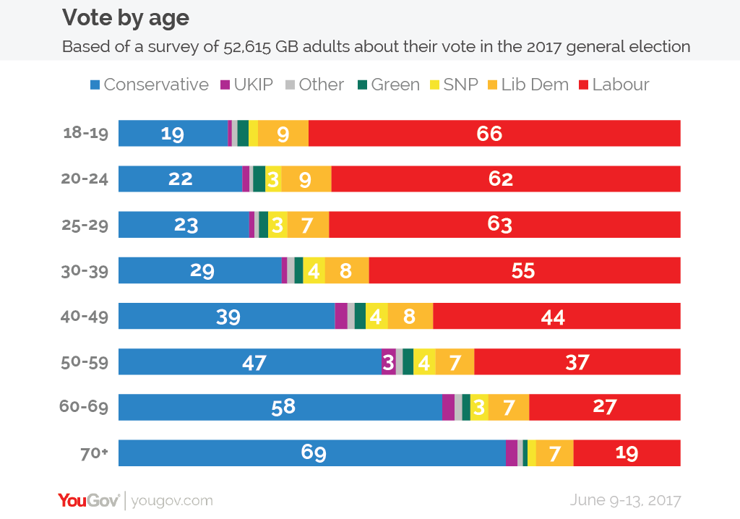
A New Deal for a New Generation

Slide 4
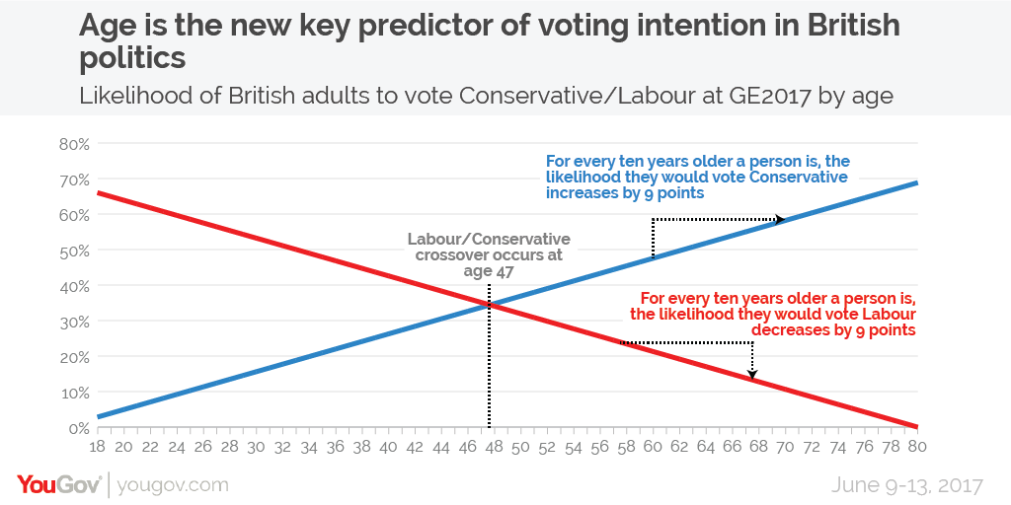
A New Deal for a New Generation

Slide 5
A New Deal for a New Generation

Slide 6
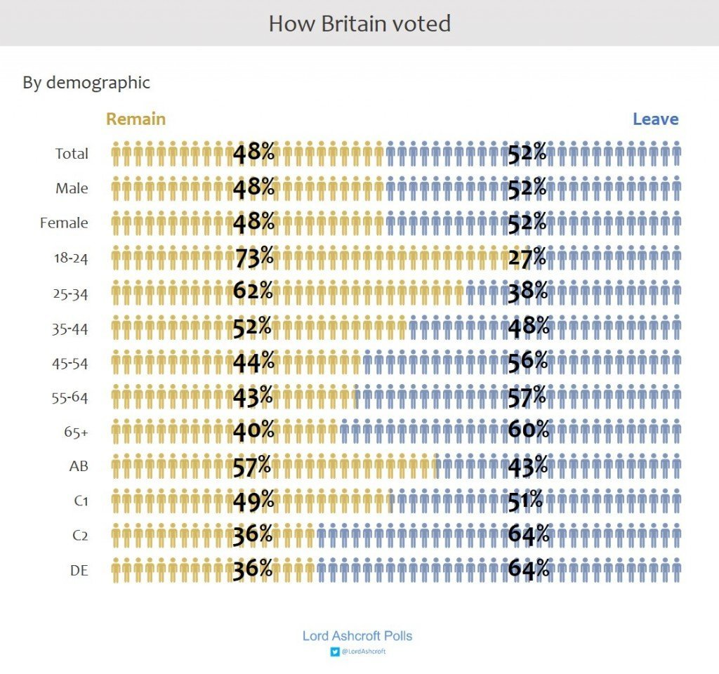
A New Deal for a New Generation

Slide 7
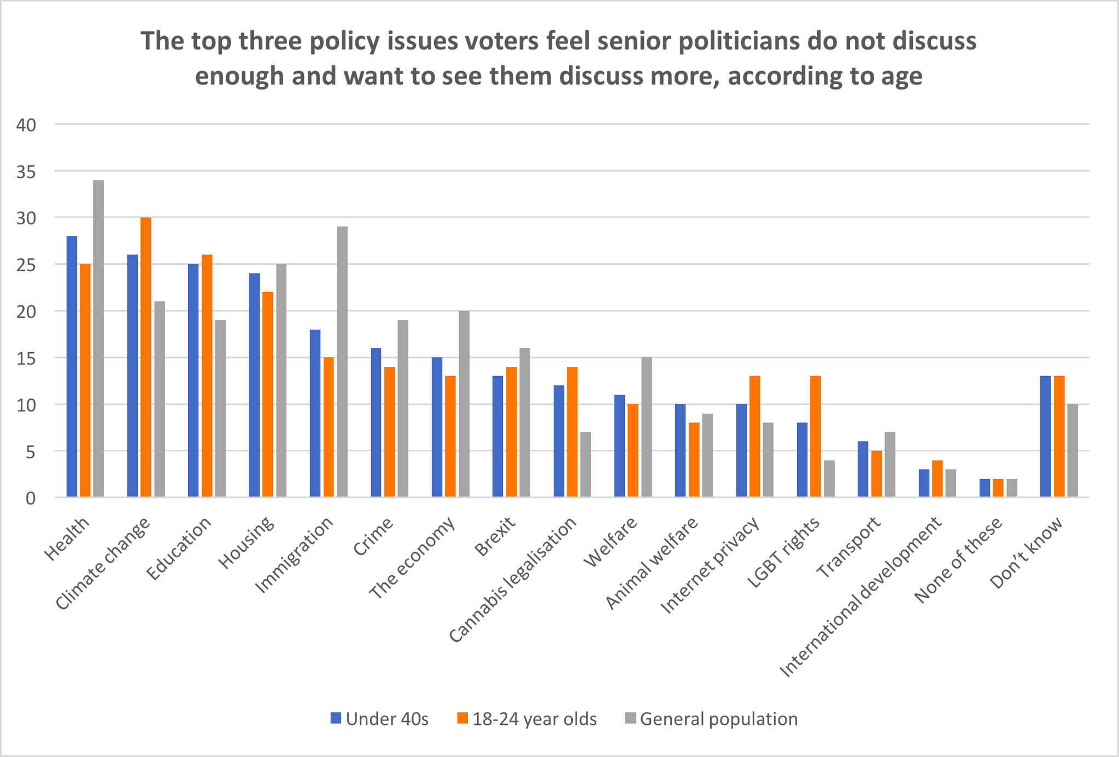
A New Deal for a New Generation

Slide 8
Questions for discussion
Time for a New Deal for a New Generation?
How can we make the Conservative Party once again the party of young people?
How should we tackle the central issues facing younger voters:
(1) tuition fees / student debt,
(2) house price unaffordability, and
(3) costs of private renting?

Slide 9
Questions for discussion
Time for a New Deal for a New Generation?
How do we restore the faith of younger people, the majority of whom voted to remain in the EU and for whom Brexit is in danger of being an alienating moment instead of an inspiring moment of national renewal?
If you could introduce up to three specific policies to signal that we are the party of the next generation, what would they be?

Slide 10
Tuition fees
“A powerful university cartel is interwoven with parts of the establishment and cares little about its students, who many academics view as an inconvenience. The universities are just focused on the money. The 2017 general election brought the issue of student costs to the foreground.”
(UK2020, 30 August 2017)

Slide 11
Tuition fees
“While students are still at university, their debt pile grows at an interest rate above 6 per cent, which officials at the Department for Education have accurately described as “bonkers”. The government’s unusual methodology for calculating interest increases lifetime repayments by £40,000 for higher earners, according to analysis by the Institute for Fiscal Studies, compared with a system in which no interest accrues beyond consumer price inflation.”
(The Times, 18 October 2017)

Slide 12
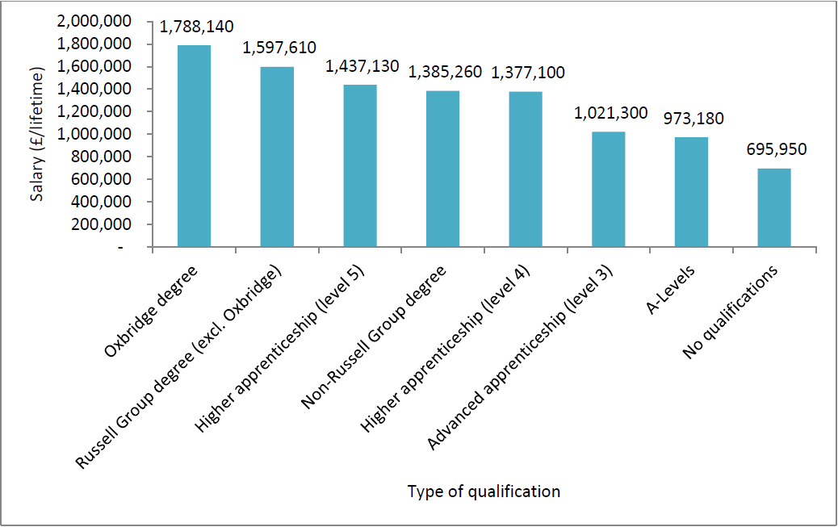
Tuition fees

Slide 13
Questions for discussion
Tuition Fees
Given that taxpayers already have to pay for students’ unpaid loans, how might the Treasury better contribute towards the costs of students’ higher education?
Is the current system working fairly? Is the 6% compound interest rate fair? Is the £9,000 cap on fees right?

Slide 14
Questions for discussion
Tuition Fees
How do we get the right balance between supporting the brightest students from disadvantaged backgrounds and all allowing our top Universities to remain world class?
What other changes could be made to improve the funding of higher education and its transparency?

Slide 15
Affordable Rents
“If we’re going to make this a country that works for everyone, we need housing that works for everyone. And that’s true regardless of whether you’re an owner-occupier, a private rental tenant, or living in social housing.”
(Sajid Javid, 19 September 2017)

Slide 16
Affordable Rents

Slide 17
Questions for discussion
Affordable Rents
How can Conservatives promote cheaper rented housing so that our young people can save?
How might we liberate ourselves from the assumption that owning a house is the only way to have a stake in society? How can we deliver a new deal for the next generation?

Slide 18
Next steps
Deadline for submissions on youth issues discussion paper:
31 December to CPF.Papers@Conservatives.com
Submissions summary sent to Minister: by end-January 2018
Ministerial response to submissions: expected in spring 2018
Future discussion paper plans: January/February 2018 topic will continue to explore issues of particular concern to young people; exact policy area will be confirmed later in 2017

